Slide 1
VICTRIX PRO V2

Slide 2
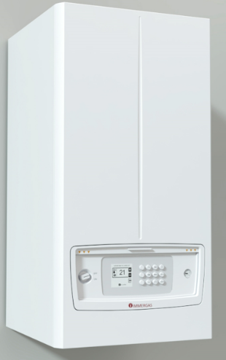
VICTRIX PRO V2 range
Condensing wall-hung boiler (central heating only)
VICTRIX PRO V2 35
VICTRIX PRO V2 55
VICTRIX PRO V2 80
VICTRIX PRO V2 68
VICTRIX PRO V2 100
VICTRIX PRO V2 120
VICTRIX PRO V2 150
VICTRIX PRO V2 180

Slide 3
Premise
With the renewal of the VICTRIX PRO range, we are improving performance and system arrangements, as well as expanding the range of light commercial condensing wall-hung boilers, with the aim of achieving an upgrade of our offer in the Professional segment.
These aspects are the basis of the intervention that has been implemented; the main targets have been:
extension of the heat output range up to 180 kW, with consequent expansion of the number of models;
electronics update to achieve greater system arrangements;
reduction of overall dimensions in cascade installations;
possibility of functioning with mixtures up to 20 vol.% of hydrogen.

Slide 4
VICTRIX PRO V2
Main features
Hydraulic Circuit
Gas and Flue Circuit
User interface
Electronic card and parameter programming
Calibration
Accessories and Optional

Slide 5
Main features
Central heating boiler (possibility to connect an external storage tank with 3-way valve kit for DHW production)
Available output : 35, 55, 60, 68, 80, 100, 120, 150 ,180 kw;
Modulation range from 10% to 100% (up to model 120);
Pneumatic gas valve, as on the current range (different codes for Natural Gas and LPG) ;
Modulating low consumption circulators;
Setting and programming with buttons and wide display;
Can manage 2 heating zones; ( 1 High temp. and 1 Low temp. by mixing valve)
IPX5D electrical insulation;
Outdoor installation with cover kit;
Frost protection until -5°C CH and DHW ( with optional until -15°C);
“Simple cascade” installation (max 5 boilers without cascade regulator);
Stainless steel condensing module (much appreciated characteristic in this market segment);

Slide 6
Main features
Standard C type configuration, without upper cover (optional) concentric and twin flue pipes available; With this optional kits the B₂₃ type configuration is possible: with air inlet B₂₃ terminal for indoor installation, or with upper cover (for outdoor installation);
“Simple cascade” (without cascade regulator), with an increase in the number of generators that can be connected, up to 15;
For indoor installation, inside the cabinet (up to 150 model) and outdoor in open areas (with optional cover kit), IPX5D protection index;
Through the new boiler electronics it is possible to manage 2 system CH Zones + 1 DHW circuit;
Available communication protocols: Modbus for BMS systems, OpenTherm (two OT inputs available for commercial thermoregulation, one for each zone), EBV BUS;
Maximum working pressure of 4,4 bar (for models up to 80 kW), 6 bar for higher heat output models (different safety valve);

Slide 7
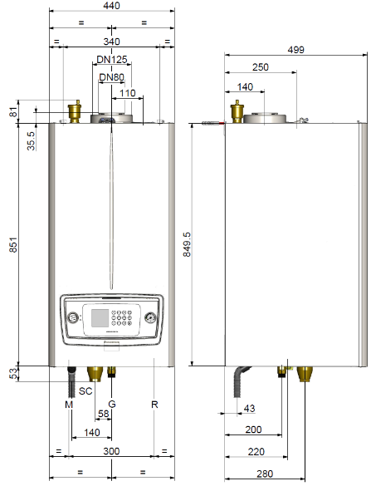
Dimensions and connections
VICTRIX PRO 55-60-68-80 V2
Models | Height (mm) | Width (mm) | Depth (mm)
 | 851 (986) | 440 | 499
 |  |  | 627
Connections
FLUE | GAS | SYSTEM
 | G | R | M
D. 110 | ¾” | 1’’ 1/2 | 1’’ 1/2
Key:
V - Electrical supply
G - Gas supply
R - System return
M - System delivery
SC - Condensate drain (Ø13mm min. internal)

Slide 8
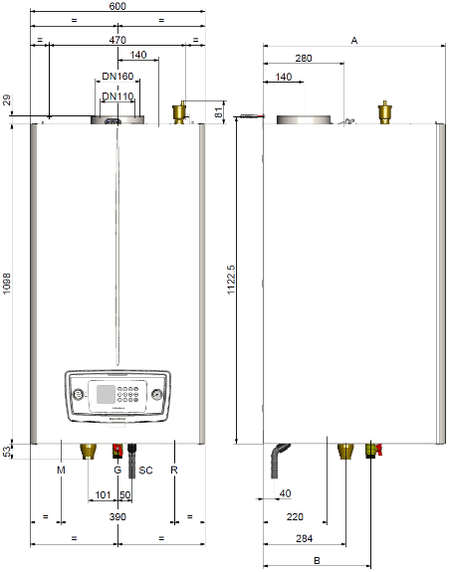
Dimensions and connections
VICTRIX PRO 100-120-150 V2
Models | Height (mm) | Width (mm) | Depth (mm)
100-120 | 1098 | 600 | 557
150 | 1233 |  | 627
Connections
FLUE | GAS | SYSTEM
 | G | R | M
D. 110 | 1’’ | 1’’ 1/2 | 1’’ 1/2
Key:
V - Electrical supply
G - Gas supply
R - System return
M - System delivery
SC - Condensate drain (Ø13mm min. internal)

Slide 9
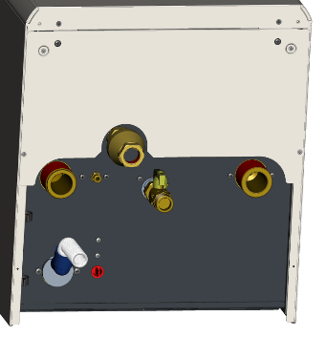
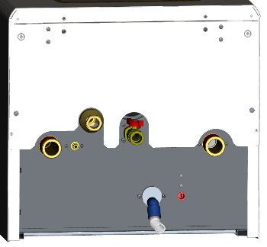
Dimensions and connections
Lower Cover
Safety valve connection
Delivery flow pipe G 1 ½’’
Return flow pipe G 1 ½’’
Gas Pipe
G 3/4’’ (35-55-80)
G 1’’ (100-120-150)
Condansate drain
Antifreeze kit
Victrix 35-55-80 Pro V2
Victrix 100-120-150-180 Pro V2

Slide 10
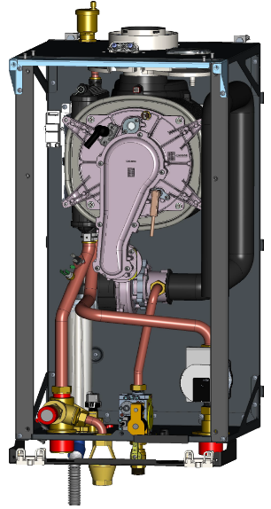
Main components; 55-60-68-80 models
Air vent valve
Flue connection D.80-125 with condensate drain discharge
Thermalfuse
B&P Spark generator
IsoPower condesing module
Air intake
Detection electrode
EBM Fan
Venturi Polidoro
Drain condensate
Pressure Transducer
WILO pump
Safety valve 4 bar
Sit 848 gas valve

Slide 11
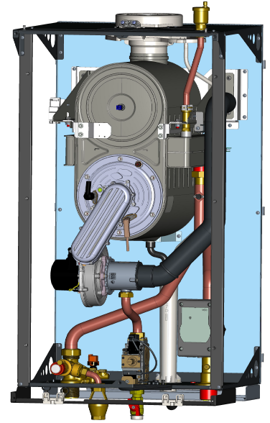
Main components 100-120-150 models
Flue connection D.110-160 with condensate drain discharge
Air vent valve
Thermalfuse
Spark generator:
B&P (for 100-120 models )
Brahma (for 150 boiler)
Duo Power condensing module
Gas collector
Ignition electrode
Detection electrode
EBM Fan
Air intake
Venturi Polidoro
Pressure Transducer
WILO pump
Safety valve 5,4 bar
Drain condensate
Gas valve

Slide 12
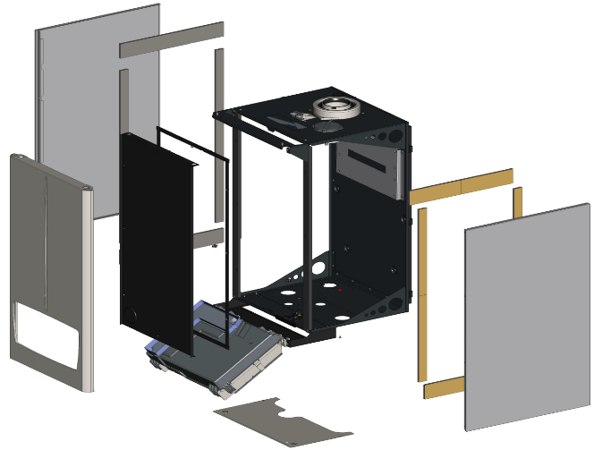
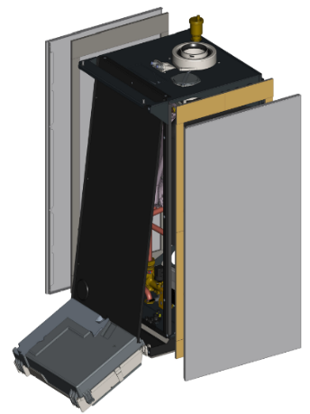
Sealed chamber; 55-60-68-80 models
Unlike the previous range, the new models have a sealed chamber made with the sides of the casing and a front sealed chamber cover.
side sealing strips
Upper closing plate S.C
Frame
Sealed Chamber front panel
Hinges

Slide 13
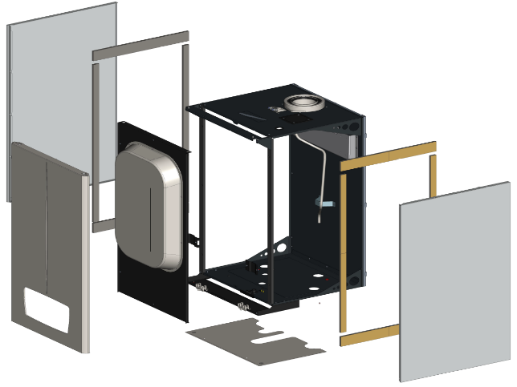
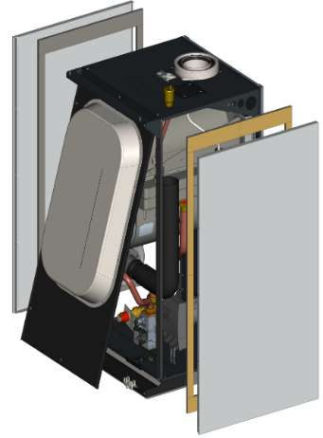
Sealed chamber; 100-120-150-180 models
side sealing strips
Upper closing plate S.C
Frame
Sealed Chamber front panel
Hinges

Slide 14
VICTRIX PRO V2
Main features
Hydraulic Circuit
Gas and Flue Circuit
User interface
Electronic card and parameter programming
Calibration
Accessories and Optional

Slide 15
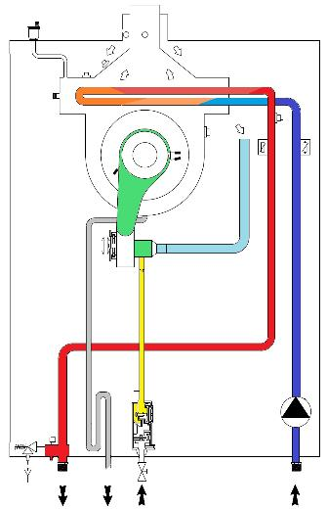
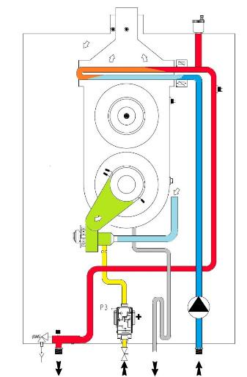
Hydraulic circuit
Victrix PRO 35 – 55 - 80
Victrix PRO 100- 120 - 150

Slide 16
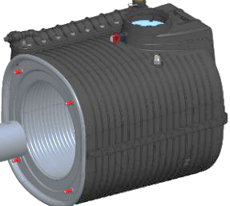
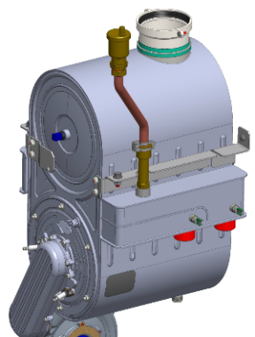
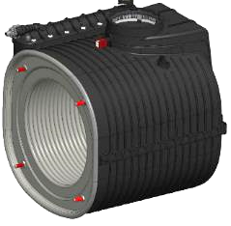
VICTRIX PRO 60-68-80 V2 Condensing module
V-PRO 35 V2
IsoThermic 4+1
V-PRO 60-68-80 V2
IsoPower 7+2 module
V-PRO 100
Condensing module 8+4
V-PRO 55 V2
IsoPower 5+2 module
Compared to previous versions, there is no plant flow sensor on condensing modules with composite casing, because the feedback-pump signal is used to intercept the locked rotor.
In this way the burner is stopped immediately.

Slide 17
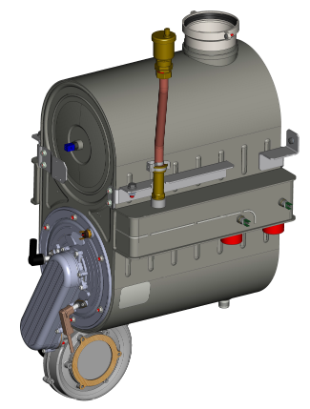
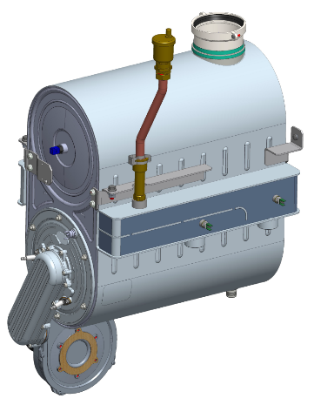
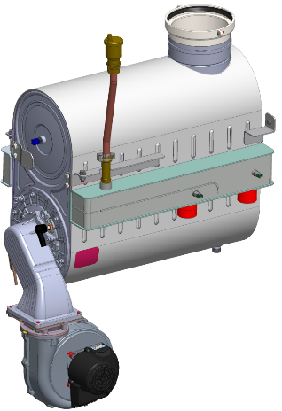
VICTRIX PRO V2 Condensing module
Condensing module 10+5
Condensing module 12+6
Condensing module 15+8
VICTRIX PRO 100
VICTRIX PRO 150
VICTRIX PRO 180

Slide 18
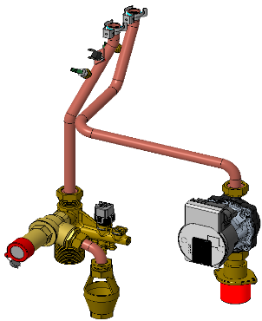
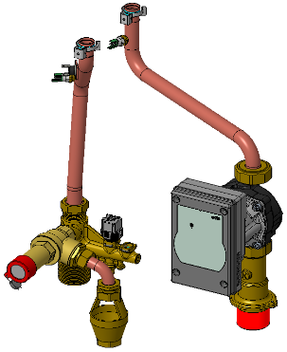
Hydraulic circuit
Victrix 35-55 Pro V2
Victrix 60-68-80 Pro V2
Flow and return NTC probes
Overheating Safety Thermostat 105°C
WILO pump
PARA 15/8- 75 W for 35
PARA 15/8- 87 W for 55
Flow and return pipes
WILO pump
PARA MAXO 25/10-130
Safety valve 4 bar
Safety valve 4 bar
Drain connection pipe
Drain funnel
CAMPINI pressure transducer
Drain connection pipe
Drain Funnel
Victrix Pro 35-55-60-68 and 80 V2 different in circulators type and some connection pipes.
New CAMPINI 5.5 bar transducer, for all boilers versions
Pipe diameter 18 mm ( for 35 ) and 22 mm ( from 55 up to 80 )

Slide 19
Hydraulic circuit - Circulator
Victrix Pro V2 35-55 EU
Victrix Pro V2 60-68-80-100-120 EU
LED STATUS
LED off: circulator not powered
fixed Green LED: circulator powered or running
flashing Red LED (temporary error): pump is making attempts to unblock; overload; pump driven by external flow; overtemperature;
overvoltage; undervoltage
fixed Red LED (permanent error): pump blocked (unblock the rotor mechanically - de-energise for approx 30 sec. in order to reset the pump's internal error); faulty motor
Red / Green flashing LED (signalling): dry running; overload; overtemperature; undervoltage
LED
LED
During DHW mode, the circulator pump always runs at full speed.

Slide 20
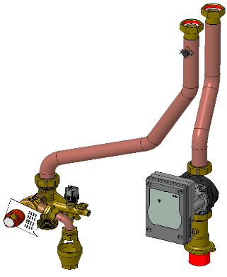
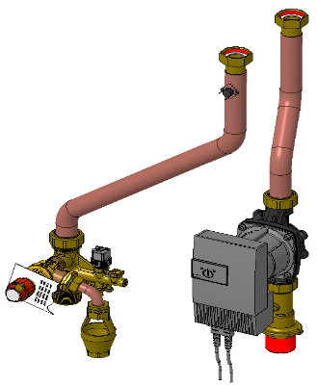
Hydraulic circuit
Victrix 100-120 Pro V2
Victrix 150-180 Pro V2
Overheating Safety Thermostat 105°
Overheating Safety Thermostat 105°
Delivery flow and return pipe d.22
Saftey valve 5,4 bar
Tubes with a diameter of 35 mm
WILO pump
PARA MAXO 25-10-130
Return flange G 1 ½'' as on circulator
WILO pump
STRATOS PARA T12 25/12
New WILO pump:
Wilo PARA MAXO 25/10-130-PWM-F21 ( same for 100-120 )
Wilo STRATOS PARA T12 25/12-180-PWM-6 ( for 150 )

Slide 21
Pump flow rate / head
VICTRIX PRO 80 V2
VICTRIX PRO 55 V2

Slide 22
VICTRIX PRO V2
Main features
Hydraulic Circuit
Gas and Flue Circuit
User interface
Electronic card and parameter programming
Calibration
Accessories and Optional

Slide 23
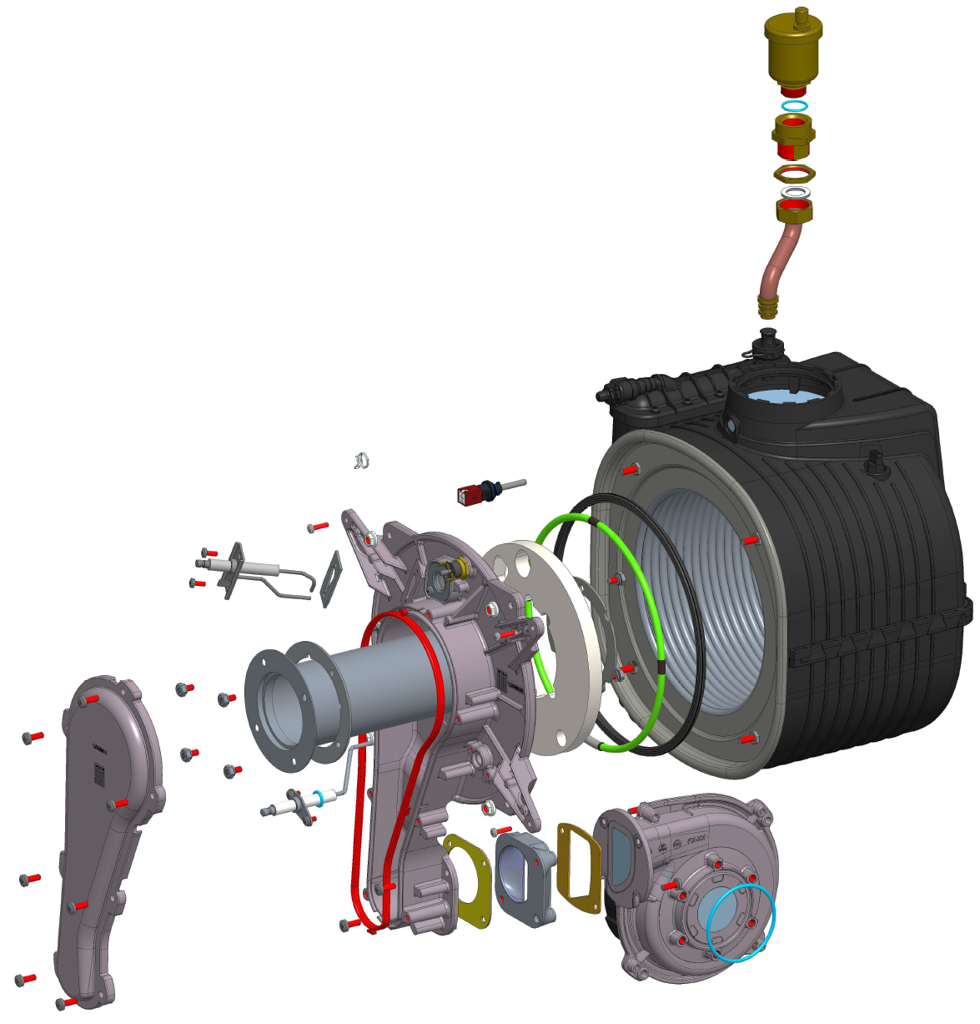
VICTRIX PRO 35 V2 combustion
Condensing module IsoThermic 4+1
Flue probe with thermal cutoff
Gas manifold same of
Victrix Pro 35-55
Ignition electrode Victrix Pro
Polidoro burner cod. 1.040670
New detection electrode Robertshaw
Fan adapter
Fan EBM VGR100

Slide 24
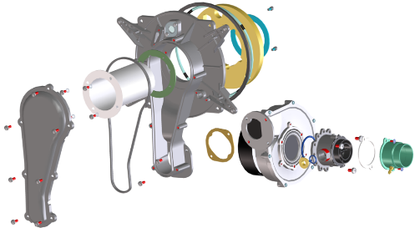
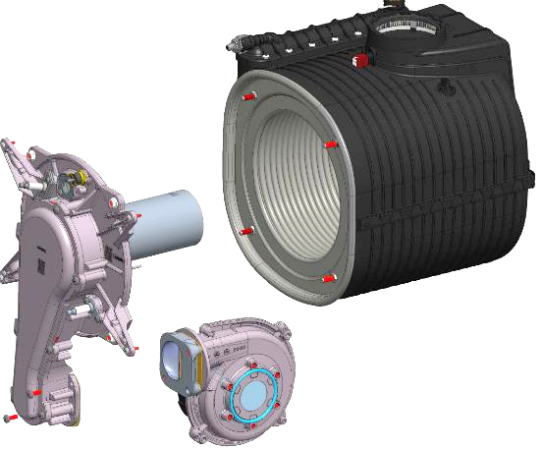
VICTRIX PRO 55 V2 combustion
Iso Power 5+2 module
Flue probe with thermal cut-off
Polidoro burner
Ignition electrode
Victrix Pro
ISOPOWER condensing module 5+2
Gas valve SIT 848 230V
Mixer (Venturi group) placed before the fan (it works in depression, lower friction loss)
Fan EBM VGR100
Gas manifold Victrix Pro 55
New detection electrode
Fan-manifold adapter

Slide 25
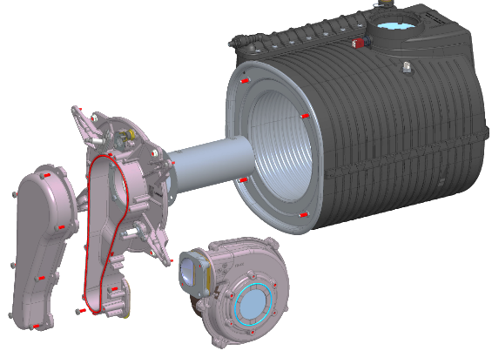
VICTRIX PRO 60-68-80 V2 combustion
Flue probe with thermal cut off
IsoPower 7+2 module
Polidoro burner
Gas manifold Victrix Pro 55
Ignition electrode
Victrix Pro
New gas manifold cover
with increased height
Fan EBM VGR108
New detection electrode
Fan-manifold adapter

Slide 26
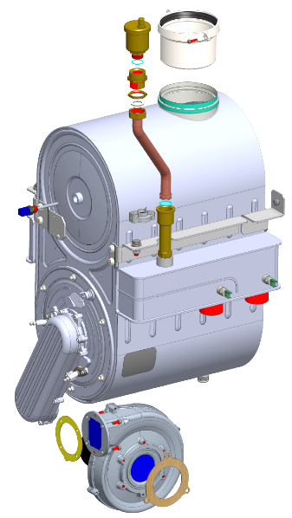
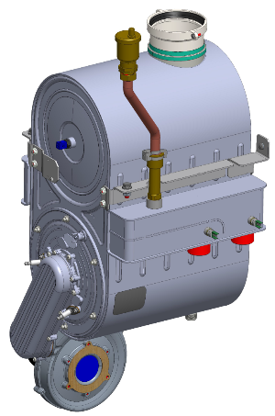
VICTRIX PRO 100 V2 combustion circuit
Condensing module 8+4
Air vent valve
Module-flange connection
Duo Power 8+4 module
Flue probe with thermal cutoff
Gas manifold for 100-120 models
Ignition electrode
Detection electrode
Fan EBM NRG137
180 W

Slide 27
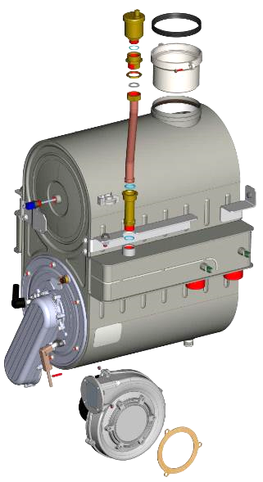
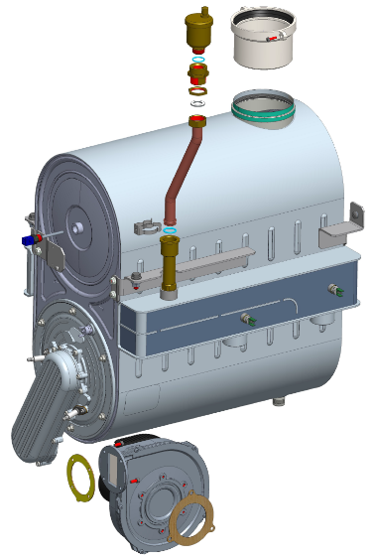
VICTRIX PRO V2 combustion circuit
Duo Power 10+5 module
Module-flange connection
Sermeta Duo Power 12+6 module
Flue probe with thermal cutoff
Gas manifold Sermeta for 150
Gas manifold Sermeta for 100-120
Ignition electrode
Detection electrode
Fan EBM NRG137 300 W
with enlarged inlet

Slide 28
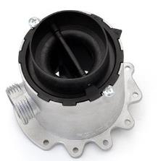
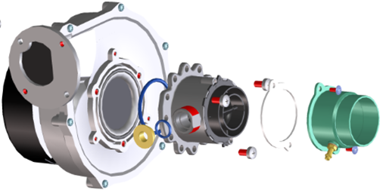
Pre-mix system
Gas nozzle
Mixer with double chamber Venturi
The Mixer has a Venturi with modular sections. The non-return valves (clapet), placed inside, partialize the section by the air movement induced by the fan.
The Mixer is positioned before the fan so it works in depression.
It guarantees lower friction loss and higher stability in power output supply.
It allows to obtain an high modulation range (1:10), because the Venturi section changes according with the air/gas flow rate.
Linear functioning even at low power (low fan rpm)
It increases the system efficiency (reducing on/off cycles)

Slide 29
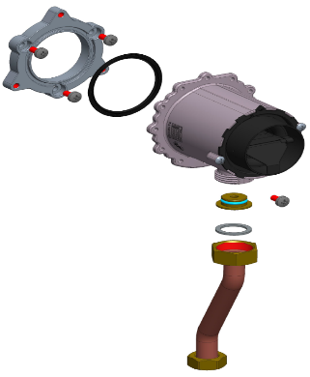
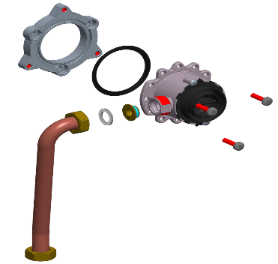
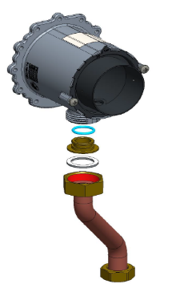
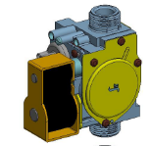
Combustion component
Venturi D. 34 - Polidoro
Venturi-Fan adapter
Venturi D.30 - Polidoro
Venturi D.26 - Polidoro
Gas nozzle
Gas nozzle
V_Pro 35 V2
V_Pro 55 V2
V_Pro 60-68-80 V2
SIT 848 gas valve is used for all boilers

Slide 30
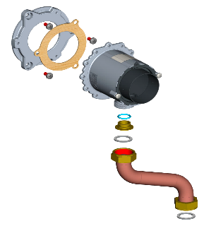
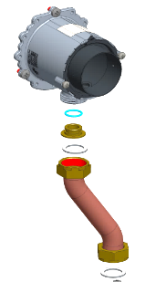
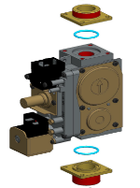
Combustion component
Victrix Pro 120 V2
Victrix Pro 100 V2
Venturi-Fan adapter
Venturi D.34 Polidoro
Venturi D.38 Polidoro
Gas nozzle
Sit 822 Gas valve for both boilers version
Leak sprays and liquids clog the pressure feedback hole of the gas valve, damaging it irreparably.
During installation and maintenance, do not use spray or liquids in the upper area of the gas valve.

Slide 31
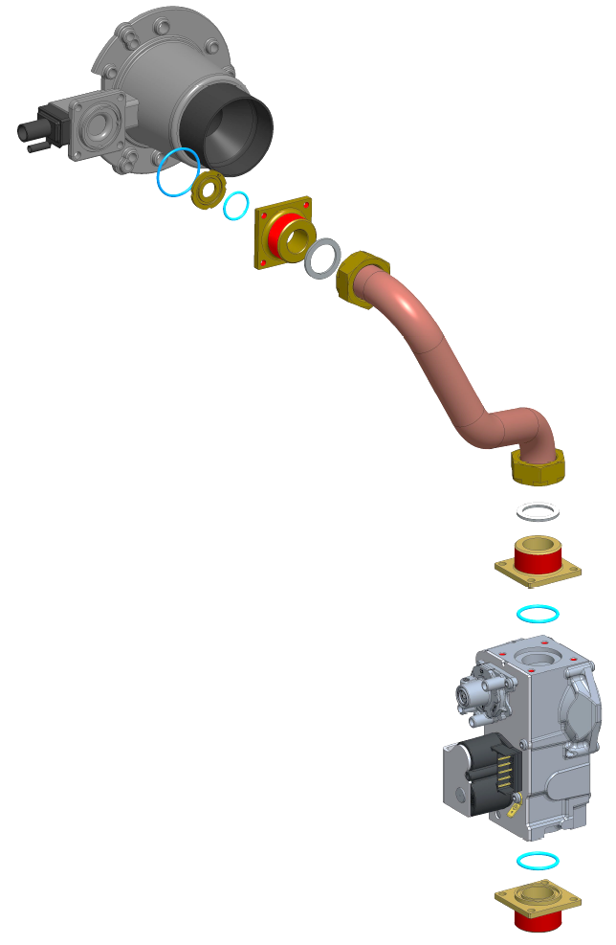
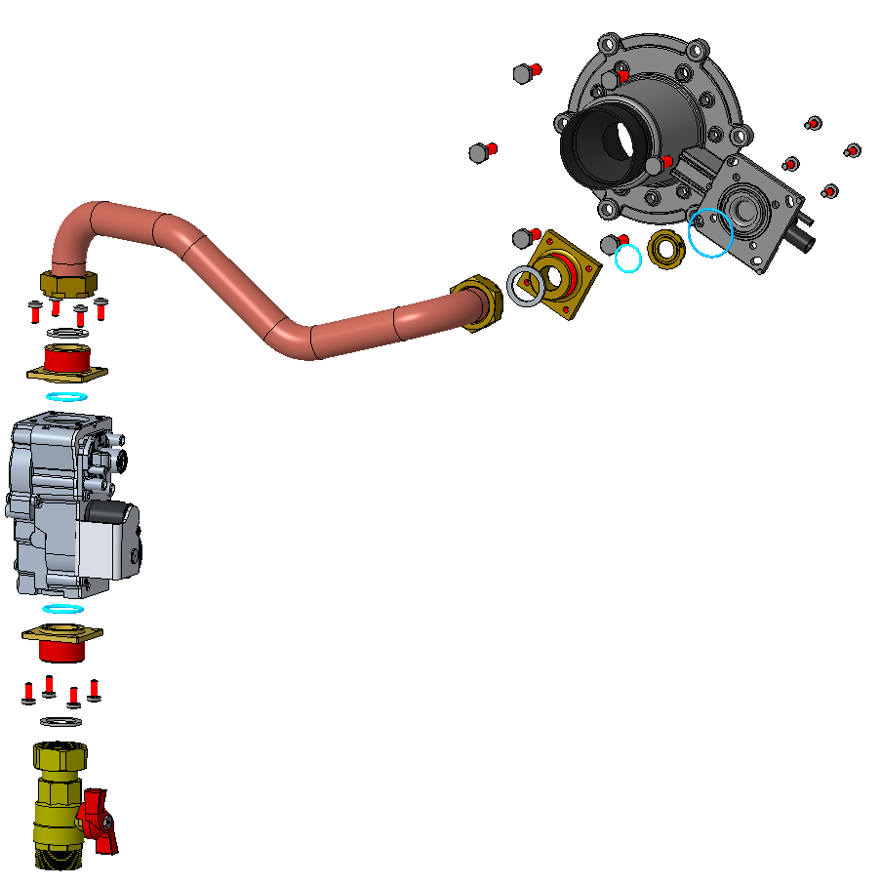
Combustion component
Victrix Pro 150 V2
Victrix Pro 180 V2
Venturi Resideo
Rambler VK4405 V
Resideo gas valve
Gas nozzle
Gas nozzle
Leak sprays and liquids clog the pressure feedback hole of the gas valve, damaging it irreparably.
During installation and maintenance, do not use spray or liquids in the upper area of the gas valve.

Slide 32
VICTRIX PRO V2
Main features
Hydraulic Circuit
Gas and Flue Circuit
User interface
Electronic card and parameter programming
Calibration
Accessories and Optional

Slide 33
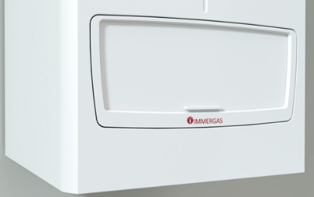
User interface

Slide 34
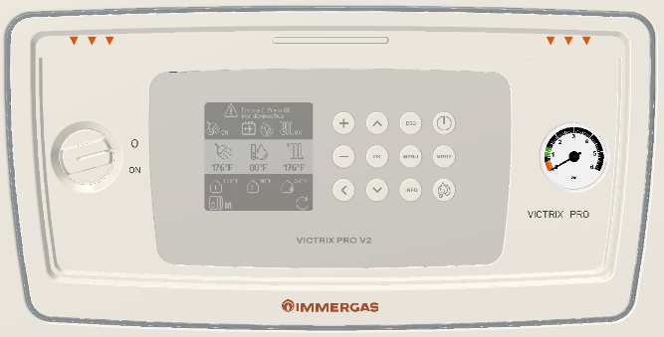
User interface
New electronics, including the display board:
Dot matrix display (black LCD with backlight);
Rubber keypad with 12 buttons (with ABS plastic surface);
On-Off knob to cut off the power supply to the single boiler;
Manometer 0-6 bar (There is a pressure transducer to view the system pressure in the Info menu and on communication BUS);
Screw type terminal blocks for the electrical connections on boards placed in the special connection compartment.
2 zones can be managed directly from the boiler electronic (1 zone can be mixed) + DHW tank

Slide 35
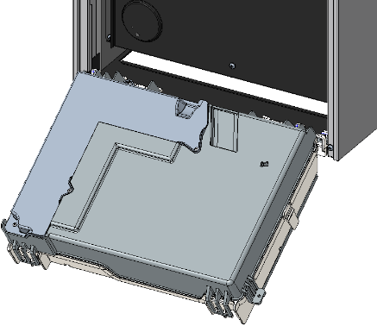
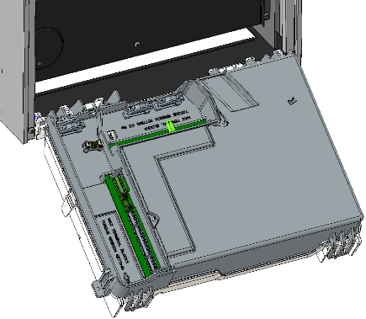
Electronics and user interface
Opening with rotation of the control panel back cover to access the display board, pressure gauge, main switch and control board; compared to today, the control panel is divided into 2 parts, to rationalize access to the electronic parts
Opening with rotation on hinges of the whole control panel.
Opening of the terminals block cover to access the electrical connection boards.

Slide 36
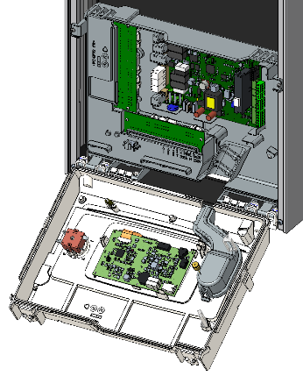
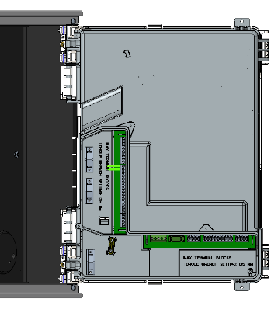
Electronics and user interface connections
“Low voltage” connection board (thermoregulation device inlets, probes and BUS communication) ( code 1.045932 )
Opening with rotation on hinges of the control panel back cover to access the display board, pressure gauge, main switch and main board
“High voltage” connection board (such as pumps and mixing valves) ( code 1.045933 )

Slide 37
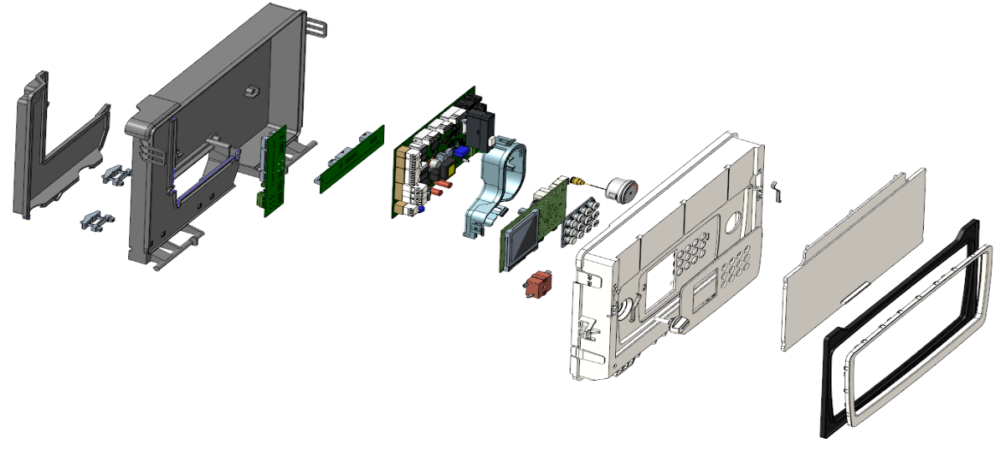
Electronics and user interface
LOW tension clamps
CLIP-IN
optional
Display PCB
Connection compartment cover
Manometer cover
Pressure
gauge
Display cover
Sliding cover
HIGH tension
clamps
Main PCB
Rear cover
Keypad
Braker circuit
Knob
Front bezel
Ahestetic frame

Slide 38
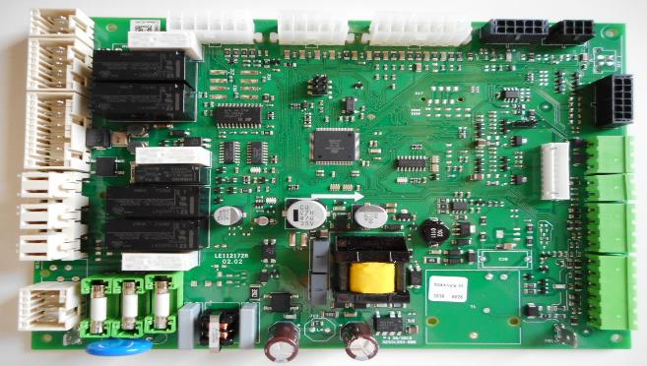
Electronics and user interface
Main board (Maxsys III ): ( code 1.045523 )
There is a greater number of relays than the previous electronic board, so that 2 system zones (one mixed) can be managed directly with the boiler electronics;
There are 5 relays 230 Vac that can be used for the outputs / loads and they are multifunctional (the function is assigned via parameter in the menu)

Slide 39



Electronics and user interface
Display board: ( code 1.045527 )
There is a clock and a calendar for programming the heating and DHW time slots;
Black dot Matrix LCD;
There is the clock and date for programming the heating and sanitary time slots (ECO, COMFORT, OFF)
Additional 2 relays are present on the display board that can be used for the loads, also multifunctional (free contact);
The function is assigned via parameter in the menu;.
Keypad
Buffer capacitor for the internal clock
2 free contact multifunctional relays on the display board

Slide 40


Electronics and user interface
Graphic INTERFACE and menus
MAIN SCREEN ON SLAVE BOILER when the «EASY CASCADE» is connected)
MAIN SCREEN

Slide 41


Electronics and user interface: settings
User menu
Service menu (password protected)
User menu
Central Heating
DHW
Holiday
Settings
Diagnostic
Maintenance
Example of a submenu
Central Heating settings

Slide 42
Electronics and user interface: settings
With this electronic board, which has a large number of relays, it is possible to manage 2 heating circuits (2 direct zones, or one direct + one mixed) + DHW tank.
This makes it possible to satisfy most installations, without having to add the cascade manager.
GENERAL SETTINGS
Possibility of parallel operation of DHW and Heating ( for low inertia systems such as fan coils, to simultaneously serve the system and DHW, "inhibiting" DHW priority);
Possibility of programming the CH and DHW time bands (ECO, COMFORT, OFF mode, Holiday, etc, etc…);
previously models there was no time band for either heating or DHW, external thermoregulation was required;
Manual test of multifunction relays that have been programmed;
Maintenance menu with the possibility of entering the Service phone number and the day/month/year of scheduled maintenance;
Air vent function ( standard enabled )
Main probe kits remain confirmed (external probe, storage tank probe, system delivery probe).

Slide 43
Electronics and user interface: settings
With this electronic board, which has a large number of relays, it is possible to manage 2 heating circuits (2 direct zones, or one direct + one mixed) + DHW tank.
This makes it possible to satisfy most installations, without having to add the cascade manager.
HEATING ZONES
Setting of differentiated 2 temperature sets, possible by setting 2 differentiated temperature curves;
2 free contacts thermostats or standard Open Therm;
Continuous pump function for heating;
DHW OPERATIONS
Management of the DHW operation with 3-way valve (230 Vac) or with external pump;
DHW cylinder can be controlled by NTC sensor or by free contact ( DHW thermostat );
Possible simultaneous DHW and heating functioning;
Anti Legionella (with NTC probe, only)
“EASY CASCADE": with the new boiler electronics you can manage up to 15 Victrix Pro V2 boilers. The limit of 5 boilers remain with IMG FLUES and HYDRAULIC KITS.
Note: The “EASY CASCADE" of the Victrix Pro V2 is not compatible with previous versions (V-Pro V1) due to V2 versions use a Modbus connection.
Notes:
Altri termostati OT ? Per il riscaldamento non ci sono problemi, sarebbe da verificare l’eventuale sanitario, se compreso nel termostato.
6 tipologie di richieste riscaldamento (Termostato con curva climatica, Termostato senza curva climatica, solo curva climatica → richiesta sempre presente, Set di temperatura costante → richiesta sempre presente, 0-10 V che agisce su % di potenza, 0-10 V che agisce sul set di temperatura)
Solo curva climatica → richiesta sempre presente, Set di temperatura costante → richiesta sempre presente.
Se voglio usare poi il contatto TA c’è un parametro con cui impostare una riduzione sulla temperatura di mandata o sulla curva climatica.

Slide 44

Electronics and user interface: comunication and protocols
MODBUS (used for BMS and simple cascade)
OPENTHERM
2 standard Open-Therm inputs are available, one for each zone;
Note: If an Open-Therm device is installed as a zone thermostat, DHW regulation can only be controlled if it is connected to the terminals of the first zone (if the device has DHW regulation).
The Honeywell T3M Thermostat tested in laboratory;
The 2 OT inputs can be used for 2 clean contact thermostats;
The IMG-BUS protocol (CAR V2) is not compatible.
BUS EBV
New EBV cascade and zones regulator
Compatible with current EBV cascade and zones regulator (code 3.015244)
Compatible with current remote control for single boiler (single installation); code 3.020358
The Clip-In VICTRIX PRO V2 is optional (same one of former VICTRIX PRO)
Note: When the device code 3.020358 - 3.015244 are used, its mandatory to install the CLIP_IN
0-10 V inlet is available (same of VICTRIX PRO)

Slide 45
Electronics and user interface: BMS
Key:
1 - Cable type: twisted pair (20 / 22 AWG)
2 - BMS (MODBUS master)
Remove jumper X40
The Modbus parameters can be found at "Technician menu / SYSTEM SETTINGS / Modbus parameters".
The parameter "CH Request type" must be set as “R.T. setpoint" (default value).
It is possible to connect the following sensors to the device and read them via BUS:
System flow sensor (B1-2)
External probe (B4)
DHW probe (B2)
DHW Thermostat/Contact
The DHW can be managed locally (appropriately configure the 3-way valve via the parameters in the "Relay settings" menu.
BMS: a pull-up resistance and a pull-down resistance must be present on the bus.
In the diagram, it is assumed that the two resistances are already present in the external device (for this reason, TR+ should not be connected with T+ and TR- with T-).
The termination resistance (120 ohms) is required on both sides of the BUS.

Slide 46

Example of hydraulic scheme
2 DIRECT ZONES + DHW 3 –WAY VALVE

Slide 47

Example of hydraulic scheme
1 DIRECTZONE+ 1 MIXED ZONE + DHW PUMP

Slide 48
VICTRIX PRO V2
Main features
Hydraulic Circuit
Gas and Flue Circuit
User interface
Electronic card and parameter programming
Calibration
Accessories and Optional

Slide 49
Electrical wires
Probe and BUS connections
MAIN board
Display board
High voltage connections

Slide 50

Electrical wires
Probe and BUS connections
The boiler has two boards:
Main P.C.B. (A2)
Display board (A37).
There are 3 fuses on the MIAN board:
A2: 5x20 T 3.15 A H 250V (F1, F2, F4).
On the connection board
A 37 : is type 5x20 6.3 A F 250V (F5).
iXTool connections
A 37 board:
High voltage connections
MIAN board
Display board

Slide 51

Electrical connections: high voltage connections
Low voltage connections: Input and BUS communication
S1 - S2 | Delivery flow probe
H - R | DHW probe or Thermostat
S3 - S4 | Low temperature zone delivery probe. (mixed zone)
G – J | External probe
OT1 - OT2 | ON/OFF R.T.1 input or Open Therm input
OT3 - OT4 | ON/OFF R.T.2 input or Open Therm input
Y – Z | 0-10 V Analogic Input
R3 - R4 | External RESET button, anomalie in corso
TR- TRD T- T+ TR+ GND | Mod Bus Slave (BMS and EASY Cascade )*
D- D+ TR- TRD T- T+ TR+ GND | Mod Bus Master ( for EASY Cascade )*
M - O | BUS EBV ( for Cascade Regulator /manager )
* The Master boiler is the one connected to the internal Modbus Master, while the Slave boilers are connected via their Modbus Slave input;
To the Master generator come the probes and activates the loads (pumps and mixing valves ), and "coordinates" all the boilers in cascade.

Slide 52

Electrical connections: loads on relays of boards
The functionality of all relays is configurable by parameter from User Interface, to make the system more flexible. The multi-function relays are accessible from the terminal block of the electrical connections board.
Power supply that gives voltage to relays
Maximum loads on relays of boards: for pumps and mixing valves and other devices are as follow…
Multi-function relays (230 V) | Current | NOTES
K70-A1 / K70-A2 / K70-A3 / K70-A4 / K70-A5 | < 0.1 A | From factory settings, K70 relays do not perform any functions.
K70-A6 / K70-A7 | Free contact < 0.1 A | Insert an optional external relay to drive each load.
N°5 Relays 230 Vac
N°2 Relays with potential free-contacts

Slide 53
VICTRIX PRO V2
Main features
Hydraulic Circuit
Gas and Flue Circuit
User interface
Electronic card and parameter programming
Calibration
Accessories and Optional

Slide 54



CO₂ regulation (min. power)
Insert the combustion analyser in the dedicated holes placed on the top of the boiler;
Enable the «Chimney sweep» by the Technical Menu/Manual Test path, allows the technician to check combustion parameters;
Pressing the 'OK' button activates the function and displays the power percentage that can be changed with the '+' and '-' buttons.
After around 5 minutes, compare the CO₂ value with the one reported in the instruction booklet;
In case of need, set the correct value with screw n°3;
Example with VICTRIX PRO 100
Gas | CO₂ Min. heat output
G20 (natural gas) | 8,90
G31 (propane) | 10,00

Slide 55
CO₂ regulation (max power)
Enable the «Chimney sweep» by the Technical Menu/Manual Test path, allows the technician to check combustion parameters;
Pressing the 'OK' button activates the function and displays the power percentage that can be changed with the '+' and '-' buttons.
After around 5 minutes, compare the CO2 value with the one reported in the instruction booklet;
In case of need, set the correct value with screw n°12
90%
Example with VICTRIX PRO 100
Gas | CO₂ Min. heat output
G20 (natural gas) | 9,60
G31 (propane) | 10,60

Slide 56
CO₂ regulation on V_PRO V2 model 150-180
Quando e come va regolato il CO2 al max??
Solo quando regolo il max o anche al min??
Foto del venturi interno ??
Smontare venturi inter???

Slide 57
VICTRIX PRO V2
Main features
Hydraulic Circuit
Gas and Flue Circuit
User interface
Electronic card and parameter programming
Calibration
Accessories and Options

Slide 58
Accessories and Optional
IPX5D Victrix Pro 35- 55- 80 V2 cover kit
Cod. 3.033670
IPX5D Victrix Pro 100-120 V2 cover kit
Cod. 3.033671

Slide 59
Accessories and Optional
IPX5D Victrix Pro 150 V2 cod. 3.033672
IPX5D Victrix Pro Pro 180 V2 cod. 3.033689

Slide 60






Accessories and Optional
Air intake cap D.80 cod. 3.033759
Installed on V-Pro V2 from 35 to 80.
Is used witht the follow kit
3.015254
3.015255
3.015256
3.024295
3.033715

Slide 61





Accessories and Optional
Air intake cap D.100 cod. 3.033760
Installed on V-Pro 100-120-150 V2
Is used witht the follow kit
3.032715
3.032716
3.032713
3.032714
3.033716

Slide 62




Accessories and Optional
For Victrix Pro 100-120-150 V2 models
Vertical flue kit D.100 cod. 3.032713
Stainles Steel vertical flue kit D.100
cod. 3.032714

Slide 63




Accessories and Optional
Concentric vertical Kit D.80-125
cod. 3.033786
V_Pro 35-55-80 V2
Concentric vertical Kit D.110-160
cod. 3.033790
Victrix Pro 100-120-150 V2

Slide 64



Accessories and Optional
Clappè kit D.80 Inox
cod. 3.033715
Insatlled in the box
To use on the flue manifold Kit non supplied from Immergas on Victrix Pro 35-55-80 V2

Slide 65



Accessories and Optional
Clapè kit D.125 Inox
cod. 3.033716
To use on the flue manifold Kit non supplied from Immergas on Victrix Pro 100-120-150 V2

Slide 66


Accessories and Optional
Antifreeze Kit for Victrix Pro V2
cod. 3.034125
Only one kit for all range boilers.
Condensate passivator kit V_Pro V2 up to 80 kW
cod. 3.033687
Condensate passivator kit V_Pro V2 up to 180 kW
cod. 3.033688

Slide 67



VICTRIX PRO V2 technical cabinet
Previous cabinet
VICTRIX PRO
New cabinet VICTRIX PRO V2
Cabinet for VICTRIX PRO V2 55-60-68-80-100-120-150.
NOT suitable for VICTRIX PRO 180 V2

Slide 68


Single installation
VICTRIX 55-60-68-80 PRO V2
VICTRIX 100-120-150 PRO V2
3.023949
3.023949
3.023950
3.023950
3.023951
3.023952

Slide 69


Single installation with plate heat exchanger
Plate heat exchanger kit for single installation for V-Pro V2 boilers with the possibility of connection on the right or left side.
Kit including connection pipes, air vent, drain cock and connections for filling and expansion tank.
Sizing of exchanger with ∆T 20 on boiler side and ∆T 15 on system side on 80 kW version.
Sizing of exchanger with ∆T 20 on boiler side and ∆T 15 on system side on 180 kW version.
VICTRIX 55-60-68-80 PRO V2
VICTRIX 100-120-150 PRO V2

Slide 70


Single installation with dirt separator
Left exit
Right exit
Kit dirt / mud separator for single installations of all Victrix Pro V2 versions with possibility of connection on both right and left side.
VICTRIX 55-60-68-80 PRO V2
VICTRIX 100-120-150 PRO V2

Slide 71



Hydraulic options
Hydraulic separator
2 different codes for 35-55 and 80-100-120;
Standard provided with filter placed on the system return;
Cylindrical shape, insulated
Safety kit for single boiler
Thermometer
Thermometer holder
Manual reset safety thermostat
Cock for pressure gauge
Pressure gauge
Manual reset pressure switch
Cut-off gas valve
Expansion vessel connection
Min. pressure switch
3 Way – valve
Kit positioned on the system delivery;
Storage tank probe included;
230 V electrical supply;
Available from 35 to 120.

Slide 72



Thermoregulation options
External probe
On-Off room thermostat
Modulating remote control for single boiler

Slide 73



Thermoregulation options: New cascade and zones regulator
The previous regulator is replaced by the new version consisting of the user interface with display and keyboard + the terminal block with inputs and outputs, for the 3 zones standard configuration.
CLIP-IN VICTRIX PRO V2
(communication interface between boiler board and regulator)
Victrix Pro and Victrix Pro V2 use the same CLIP-IN, but for Victrix Pro V2 it is option.
Cascade and zones regulator kit V-PRO V2 it is composed of the 2 elements:
an interface part
a DIN bar electrical connection part.

Slide 74

Cascade regulator device

Slide 75


Thermoregulation options
Unlike the previous model, the CLIP-IN board is not fitted as standard on this version.
If it necessary to connected the boiler at the cascade regulator, it is necessary to have the CLI-IN device.
Clip-in for EBV bus, for Victrix Pro V2 (cod. 3.034122 )

Slide 76


Thermoregulation options
Cascade kit regulator for Victrix Pro V2
cod. 3.034119 is composed from:
1) heatcon! EC 1351 Pro
EC 1351 Pro is the main control unit
DIN rail mountable
Dimension: 210 x 90 x 61 mm
2) heatcon! MMI 200
MMI 200 is a local display to set the EC 1351 Pro
MMI 200 and EC 1351 Pro are connected by flat cable (BUS EbV)
Each EC 1351 Pro can be connected on one MMI 200
Dimension: 144 x 96 x 29 mm

