Slide 1
RAPAX V4

Slide 2
Premise
The new F-Gas Regulation, which came into force on January 1, 2027, restricts the use of fluorinated gases, impacting heat pumps and hybrid systems.
The RAPAX heat pump water heater range has therefore been updated to meet the new regulatory standards.

Slide 3
Transition timelines to new gases: regulatory obligations
Self-contained (MONOBLOCK) ≤ 12 kW | 2027: GWP < 150 2032: natural refrigerant gas only
Self-contained (MONOBLOCK) > 12 kW and ≤ 50 kW | 2027: GWP < 150
Self-contained (MONOBLOCK) > 50 kW | 2030: GWP < 150
Split A2A ≤ 12 kW | 2029: GWP < 150 2035: natural refrigerant gas only
Split A2W ≤ 12 kW | 2027: GWP < 150 2035: natural refrigerant gas only
Split > 12 kW | 2029: GWP < 750 2033: GWP < 150

Slide 4
New RAPAX V4 range – 5 model
Code | New model
3.036851 | RAPAX 100 V4
3.036852 | RAPAX 200 V4
3.036853 | RAPAX 200 SOL V4
3.036854 | RAPAX 300 V4
3.036855 | RAPAX 300 SOL V4

Slide 5
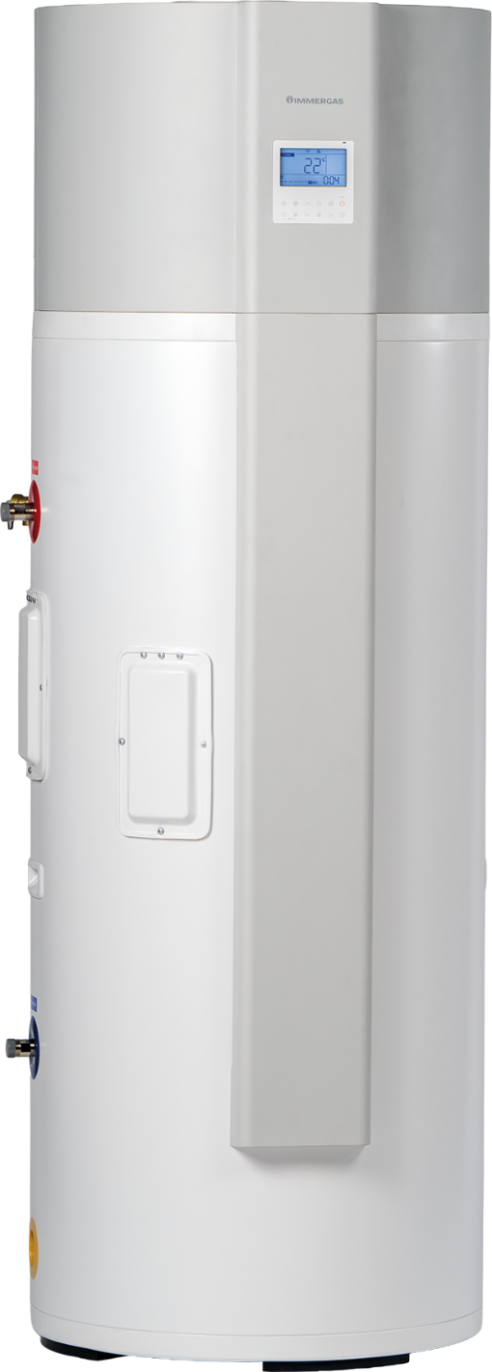
Main features
New design
Refrigerant gas: R290 (GWP = 0,02 → Negligible Greenhouse Effect)
Vitreous enamel-coated steel storage tank with polyurethane insulation up to 46 mm thick
Possibility of weekly timer setting
User interface with digital display & remote control via app – as standard
Maximum DHW temperature up to 65°C with heat pump; up to 70°C with electric heater
Photovoltaic contact as standard → heats the storage tank water to the maximum temperature
Weekly programmable anti-legionella disinfection function

Slide 6
Requirements for IU operating with R290 - use indoors
In Europe, the maximum charge for R290 in hermetically sealed systems is 150 g; above this charge, spatial requirements for the installation room must be met (for safety reasons, to ensure proper dilution of the gas in the event of a leak).
Up to 150 grams, the risk of forming a hazardous atmosphere in the event of a leak is considered negligible.
The new RAPAX V4 range complies with the 150 g limit, so there are no specific requirements set by the legislation regarding the minimum area of ​​the installation room.

Slide 7
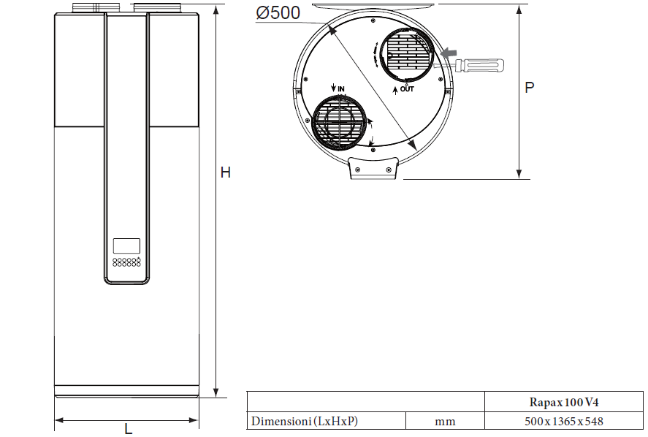
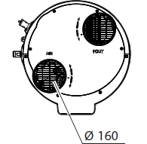
Dimensions
RAPAX 100 V4
Hydraulic connections ½"

Slide 8
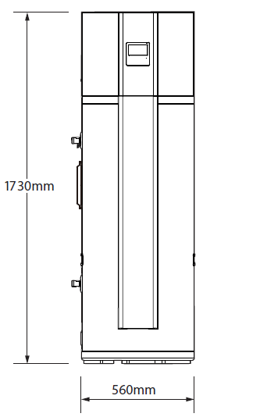
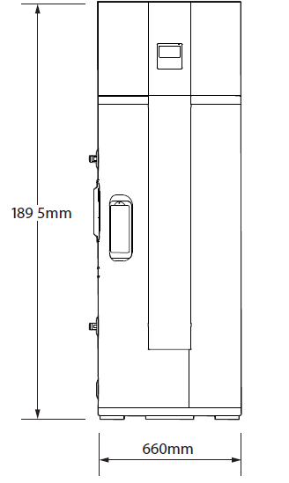
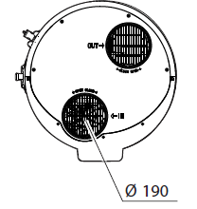
Dimensions
RAPAX 200 V4
RAPAX 300 V4
Hydraulic connections 3/4"

Slide 9
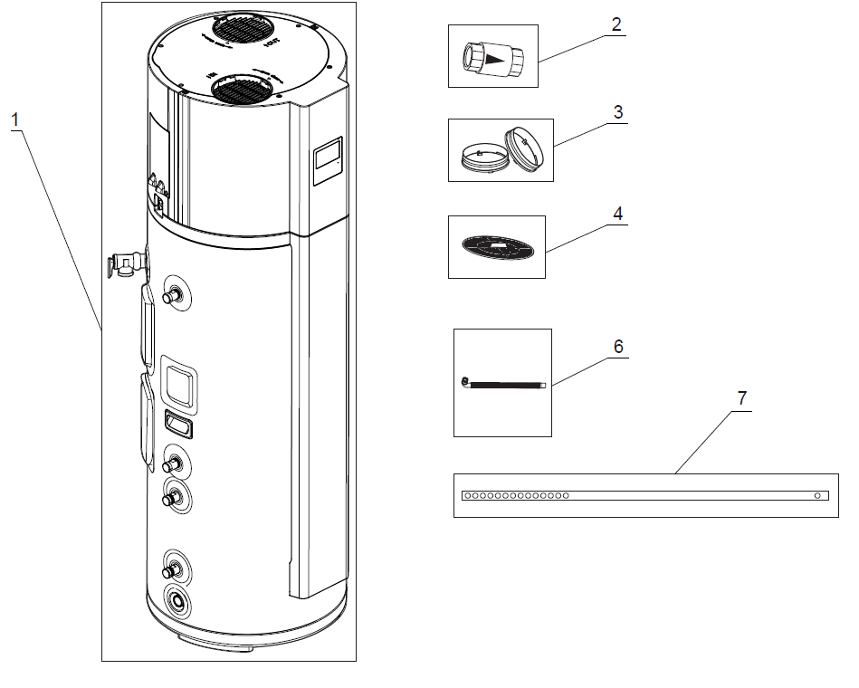
Standard components: 200/300 models
2 – One-way valve
3 - Air duct connectors
4 - Air intake filter, to be installed directly on the inlet for single-duct installations
6 - Condensate drain pipe
7 - Retaining band for possible wall fixing - the floor surface must be flat or inclined no more than 2°.

Slide 10
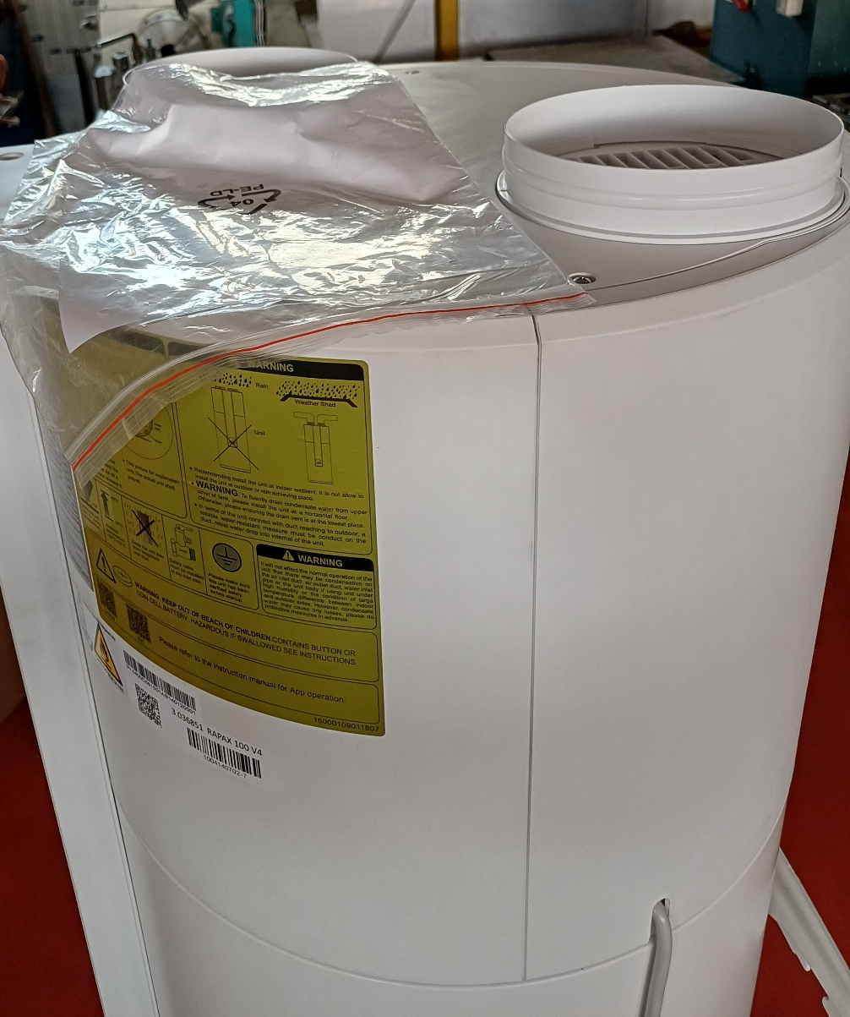
Air duct connectors
To be mounted on the top of the appliance:

Slide 11
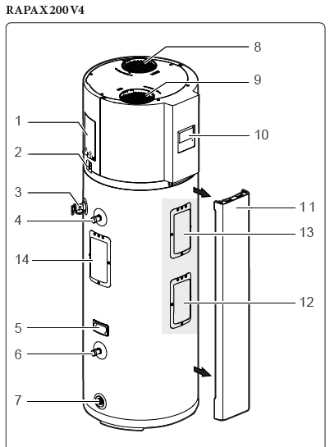
Main components
1 – Power supply
2 - Condensate drain
3 - One-way valve
4 – Domestic hot water outlet
5 - Handle
6 - Domestic cold water inlet
7 - Storage tank drain fitting
8 - Air discharge
9 - Air intake
10 - Display
11 - Front panel
12 - Electric heater
13 - Magnesium anode
14 – Not used

Slide 12
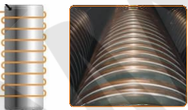
R290 condenser
Condenser wrapped externally to the boiler (not immersed), to avoid risks of water contamination

Slide 13
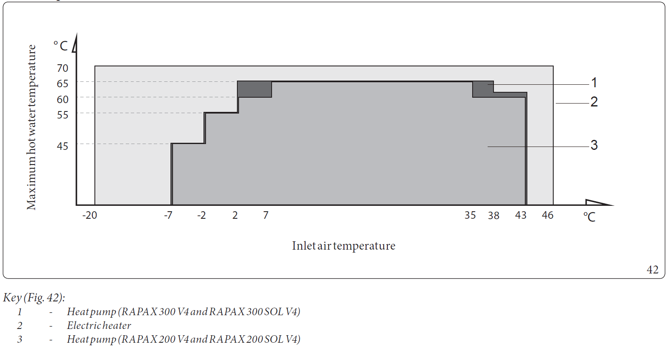
Air / water operating temperature range

Slide 14
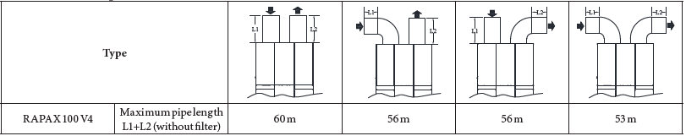
Air duct lenght for RAPAX 100 V4

Slide 15
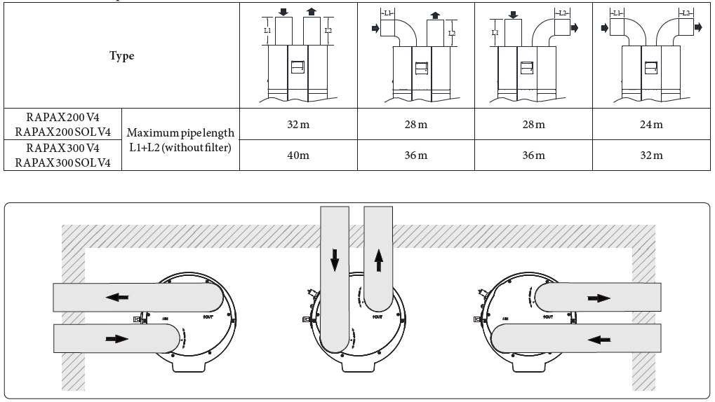
Air duct lenght for RAPAX 200/300 V4

Slide 16
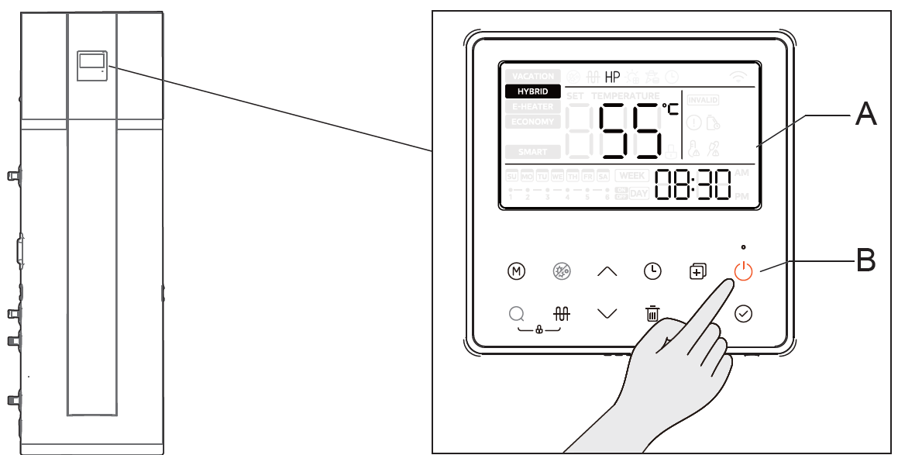
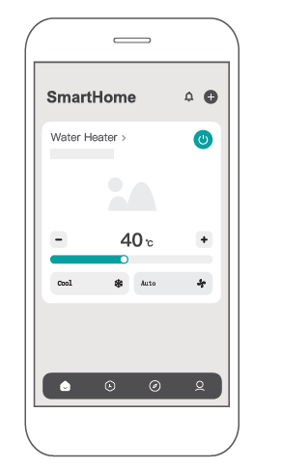
Control panel
The control panel has the same user interface on all models.
Remote control: they can be controlled via App.

Slide 17
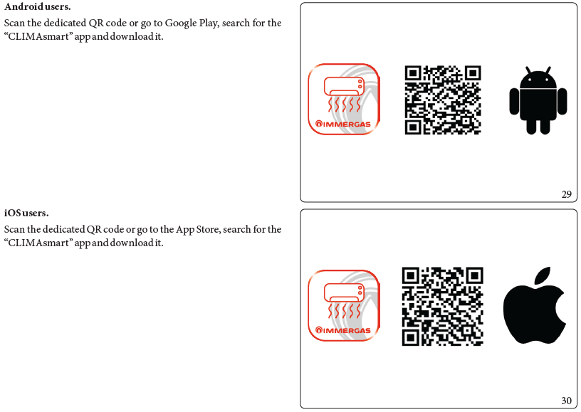
Download and installation of the App
The instruction manual contains all the instructions for the configuration, starting from the download:

Slide 18
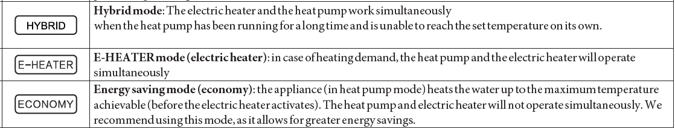
Notes on operating modes

Slide 19
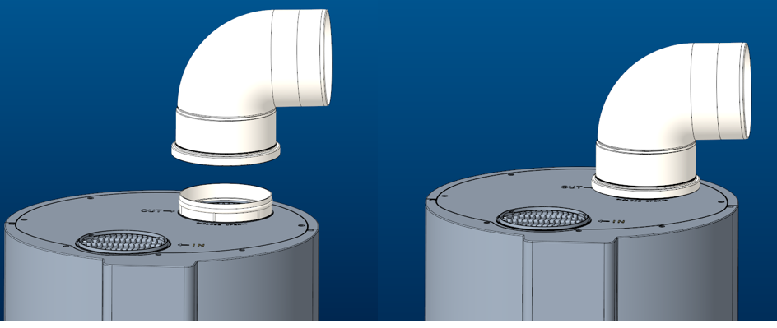
Optional kits
  3.028368 7 bar safety valve and 5 litres expansion vessel kit
  3.025231 7 bar safety valve and 12 litres expansion vessel kit
  NEW:
  3.037558 Extension duct D160 1 m
  3.037559 Extension duct D160 2 m
  3.037560 90° bend D160
  3.037561 2 x 45° bends D160
  3.037564 Extension duct kit D200 1 m
  3.037565 Extension duct kit D200 2 m
  3.037566 90° bend D200
  3.037567 2 x 45° bends D200
  Note: the current 160 mm flue kits are being replaced with a code change because we have ended our collaboration with the previous supplier; the previous kits cannot be used on the new models.
RAPAX 300 V4

Slide 20
Preliminary technical data
 | Unit | RAPAX 100 V4 | RAPAX 200 V4 | RAPAX 200 SOL V4 | RAPAX 300 V4 | RAPAX 300 SOL V4
Domestic water content | litres | 98 | 185 | 181 | 275 | 270
Inlet air temperature during heat pump operation | °C | -7 ÷ +43
Inlet air temperature for integration heating element operation | °C | -20 ÷ +46
Adjustable DHW temperature | °C | 38-70
Material | Vitreous enamel-coated steel storage tank
Corrosion protection | Magnesium anode
Nominal heat output HP* | W | 980 | 1430 | 1430 | 1500 | 1500
Integration heating element absorbed current | W | 1500 | 1640 | 1640 | 1640 | 1640
Type of refrigerant | type | R290
Refrigerant charge | g | 150
(*) Air temperature 15/12 °C (DB/WB), inlet water temperature 15 °C, outlet water temperature 45 °C

Slide 21
Availability
Range | Availability
RAPAX V4 | 3rd quarter 2026

